Slide 1

「The Wall」
By: Daniel Wu & Anthony Ma

Slide 2
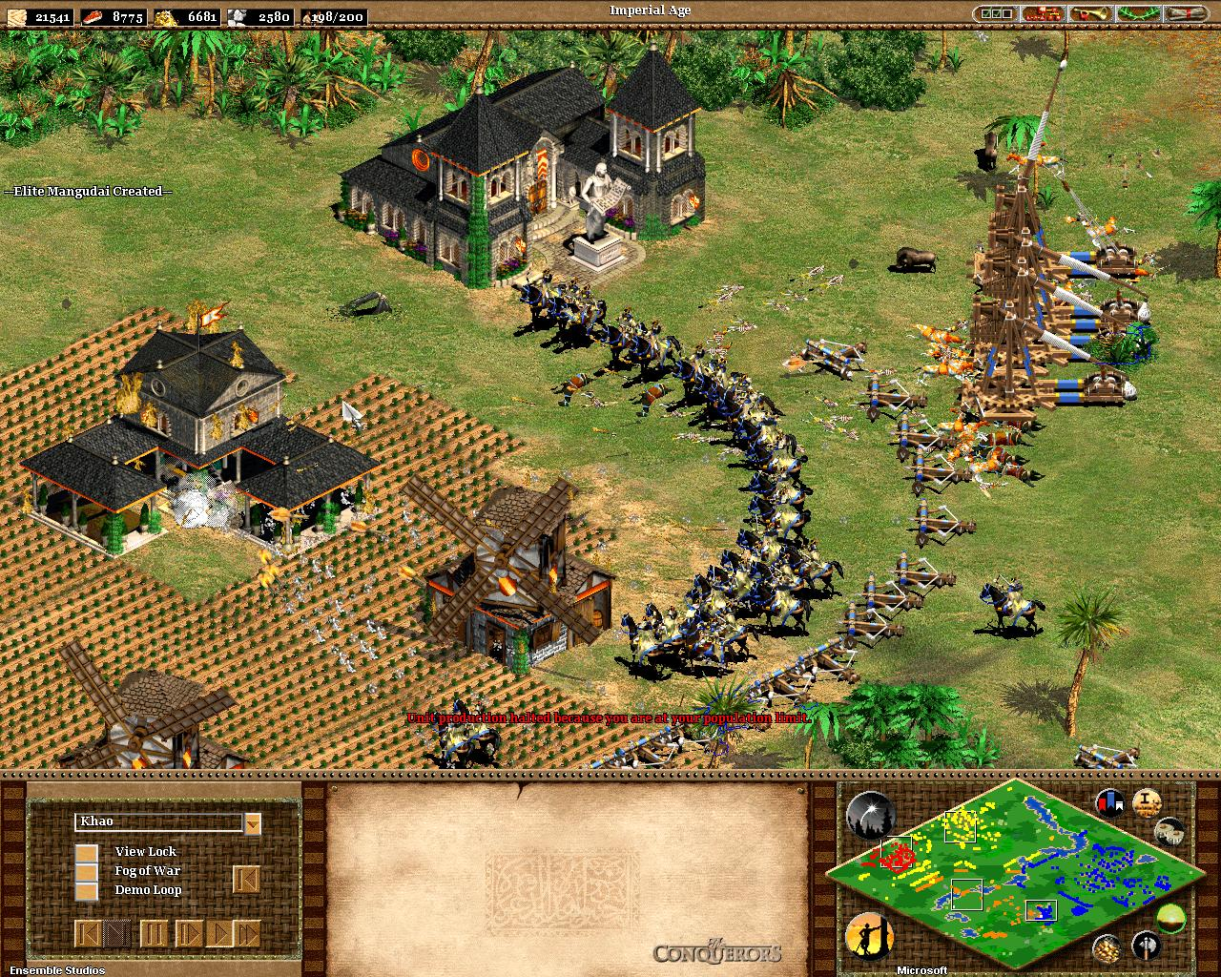
Initial ideas
Our game is similar to classic rts strategy games like age of empires 2 in that you must manage breakable defenses to protect the main base
RTS Strategy Resource management game where the goal is to survive for as long as possible in a continuous onslaught of aliens
Our unique spin involves having most micro actions automated instead focusing on a more general macro focus

Slide 3
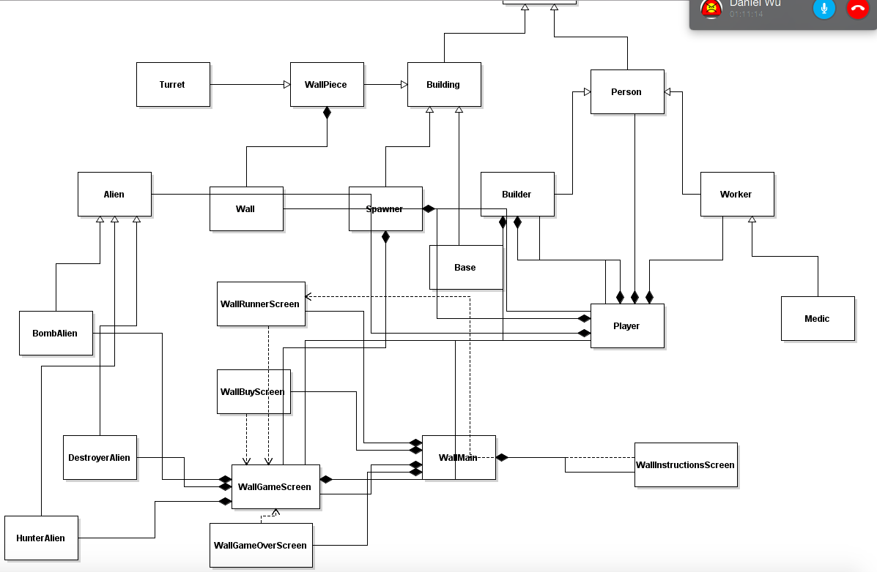
Code Overview

Slide 4

Problems
AI glitching out continuously whether it be the enemy or people
Switching from processing to swing as it became too time consuming
Getting the enemies to properly disappear and not turn into ghosts

Slide 5
Start Playing
Initial Screen should have three buttons play, settings, and instructions
Controls are simple, go to the buy menu once the game is launched and buy workers and guards
Left click the battlefield following purchasing to place new units

Slide 6
Bugs
Ghost entities that become untargetable after death
Guards and turrets will sometimes randomly take out targets rather than those closest

Slide 7
If We had More Time
Networking
Tech Tree for Walls, Workers, Guards, and Turrets
Research different weapons
Allow the player to control a person object
Base Management system

